Slide 1
Biweekly Meeting for RL Based Truck&Trailer Project
March 31 2023

Slide 2
Recently Updates
Finish the introduction, problem formulation and methodology part of the conference paper
Discuss the definition of the vehicle lateral deviation avoid zigzag problem
Finish revising the training environment of new deviation defination.
Conduct experiment on new deviation in bus model environment

Slide 3
Structure of the paper
Introduction
Background
Truck Trailer control
Deep reinforcement learning
Problem Formulation
B-spline path generation
Truck trailer kinematics
Methodology
State
Action
Reward function
Simulation Results
Conclusion

Slide 4
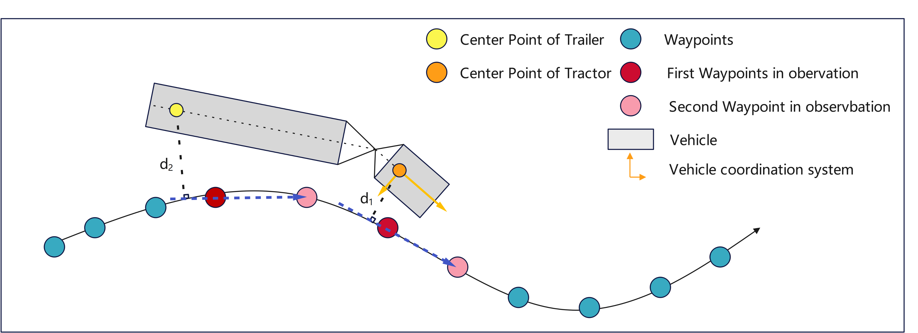
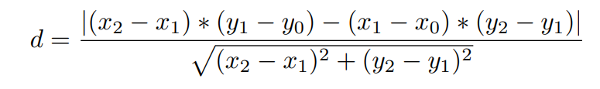

Deviation Definition

Slide 5

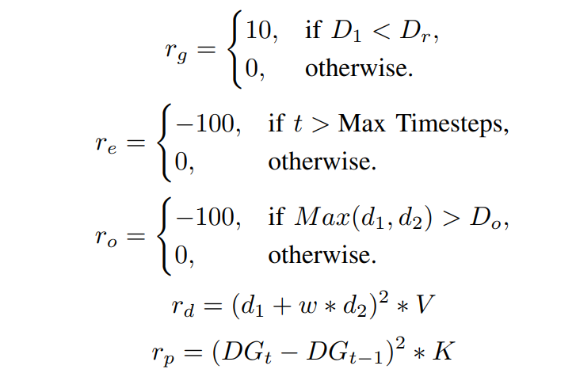
Revised Reward Function

Slide 6
Current Training Environment
Bus Model with single deviation constraint
Bus Model with weighted sum deviation constraint
Truck Trailer Model with weighted sum deviation constraint

Slide 7
Plans for next two weeks
Conduct experiments on 3 different environment to tune the hyper parameter
Craft the evaluation scenarios for trained model
Revise the paper

